Slide 1
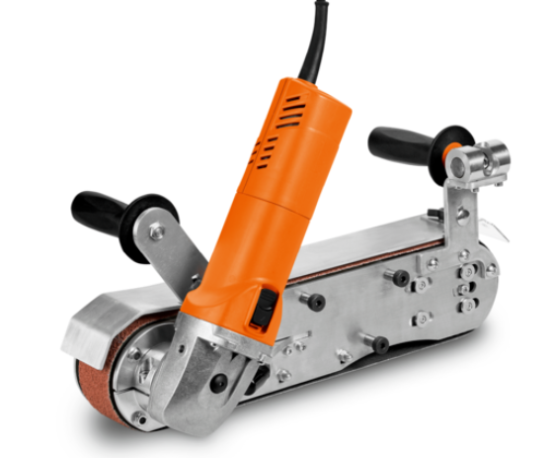
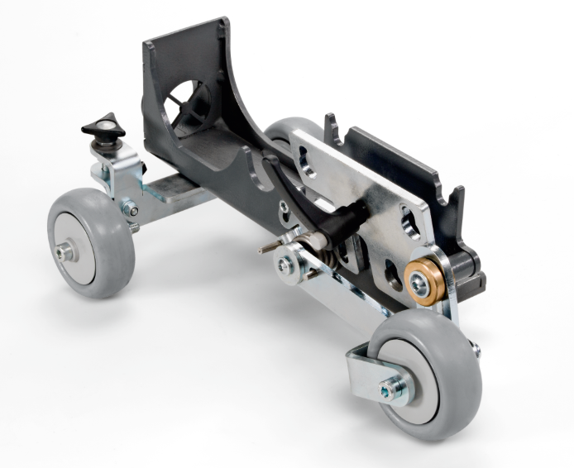
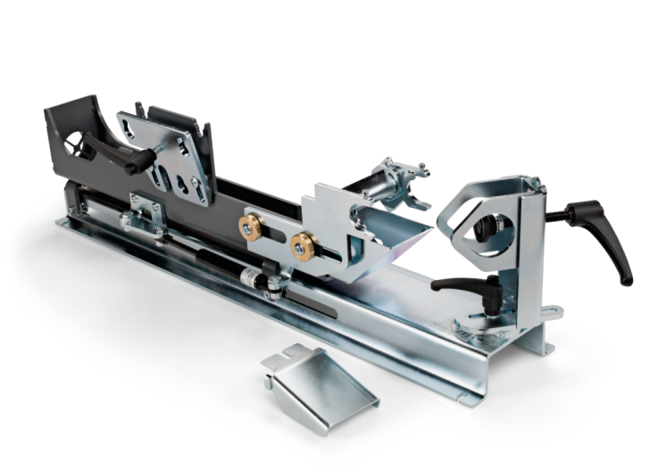
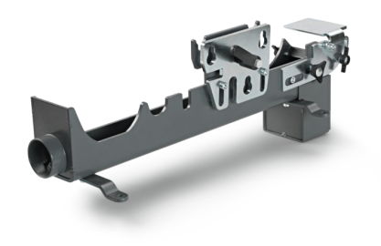
Powerful, mobile belt grinding system with new grinding modules.
Highly flexible to use
Very powerful
Extremely comfortable to use
Flexible on site operation
Round opening for pipe processing
Mobile Grinding system with versatile modules
Powerful 1500 W motor
High grinding capacity due to optimum speed
3 x faster than an angle grinder
4 m long H07 industrial cable
Tool-free belt change
Adjustable handles and motor positioning
NEW
NEW
GRIT GHB 15-50 / INOX
GRIT GHBM
GRIT GHBR
GRIT GHBD
2 powerful, hand-held belt grinders
Module for mobile surface grinding and finishing
Module for stationary pipe notching
Module for stationary belt grinding and finishing
USPs
Changing the grinding belt: No tools required, simply move the clamping lever and install the belt.
System interface: Conversion to other applications in < 45 sec.
Pivoting motor: Optimum working position as motor can be rotated nearly 360°.
Work progress: Grinds faster than an angle grinder.
Ergonomics: Grind in difficult-to-reach areas with minimal effort.
Grinding result: Radius and bevel grinding.
Why end users buy the GHB grinding system:
Purchase criterion | Product feature | Advantage | Customer benefit
Efficient grinding system | Installation of the machine in a pipe notching module | Setup time less than 45 seconds. | 1 machine for 3 different applications => All-round grinding system
 | Installation of the machine in a mobile grinding module | Excellant mobility in shop or field
 | Installation of the machine in a grinding station | Can be used as a stationary machine. Setup time less than 20 seconds.
Powerful | 1500 W motor | Efficient processing of material | Power and accessories matched to different grinding and finishing applications
 | Optimal speeds / belt speed | Optimal use of grinding belt capabilities
 | Selection of grinding, fleece and finishing belts | Machine and grinding belts matched to one another
Ergonomics | Grinding station for stationary work | Easy processing of small parts, pipes and profiles | Safe, efficient and comfortable grinding. Hand-guided and as a system
 | Tool-free belt changes | Requires no additional tools
 | Adjustable handle | Work in different application positions

Slide 2
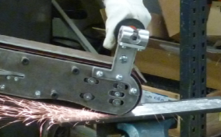
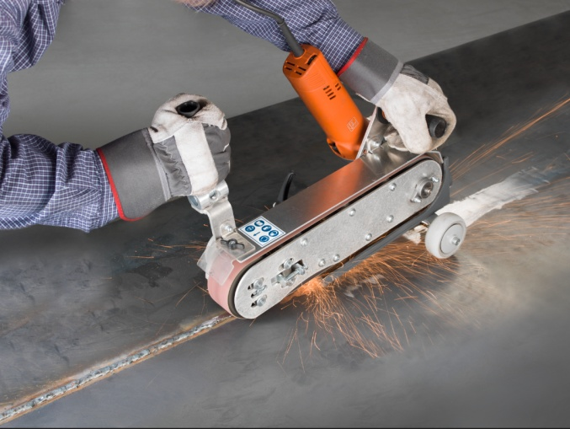
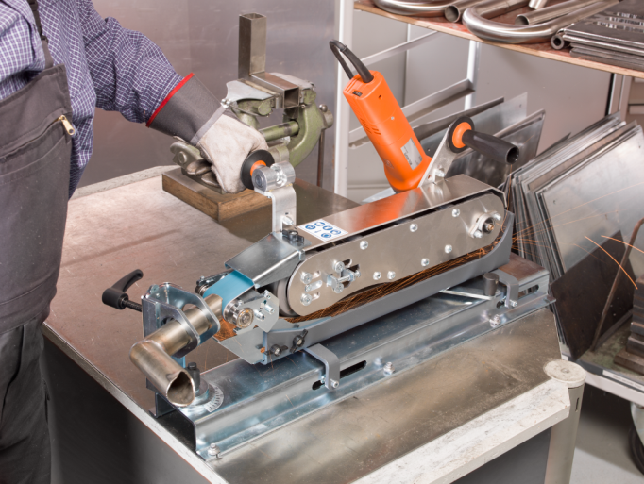
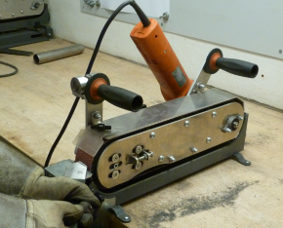
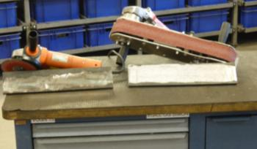
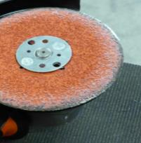
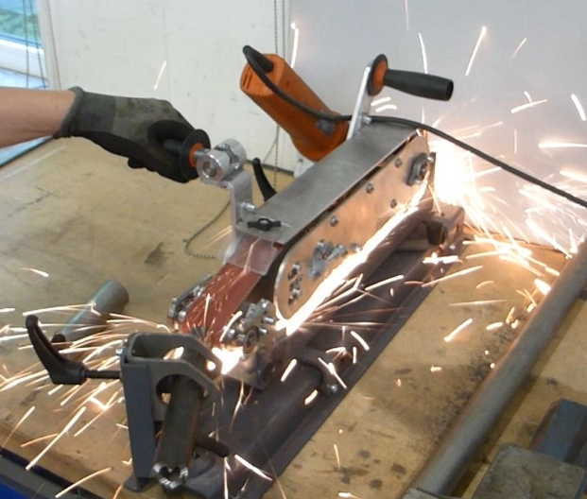
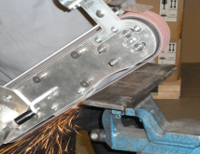
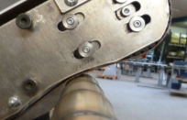
Technical features |  |  | GHB 15-50 | GHB 15-50 INOX | GHBM | GHBR | GHBD
Power consumption | W |  | 1500 | 1500 |  | Only in conjunction with GHB15-50 Inox
Power output | W |  | 900 | 900
Speed | rpm |  | 8500 | 2500 - 7900
Belt width | mm/in |  | 50/2“ | 50/2“ | 50/2“ | 50/2“ | 50/2“
Belt length | mm/in |  | 1000/39¼“ | 1000/39¼ “ | 1000/39¼“ | 1150/41¼“ | 1000/39¼“
H07 cable with plug | m/ft |  | 4/13 | 4/13
Weight according to EPTA | kg/lbs |  | 5.6/12.3 | 5.6/12.3 | 5.0/11 | 13.0/28.6 | 5.8/12.7
Order reference number |  |  | 79030109124 | 79032109124 | 99001012010 | 99001012020 | 99001012000
Includes |  |  | 1 grinding machine, 1 grinding belt |  | 1 x module. Please also purchase extensive accessories.
Target groups: Fabrication, vessel manufacturing, bridge building, machinery manufacturing, structural work
The GHB grinding system provides industry and trade with a wide range of applications as an effective alternative to angle grinders for the processing of steel and stainless steel. The grinding modules can be used efficiently in all common applications.
Container construction, shipbuilding, crane construction, piping construction, vehicle construction etc.
GHB 15-50 vs. angle grinder
3x faster chamfering and weldseam processing
Longer-lasting abrasives
Tool-free belt change
Better surface finishing
Better metal removal rate
Can also be used as a belt grinding system
Examples of use – Hand-guided and semi-stationary
System grinding:
Pipe notching
Mobile grinding /finishing
Stationary grinding
Hand-guided:
Beveling / radius work
Pipe grinding / finishing
Welded seam processing
For more information, visit www.fein.com

Slide 3
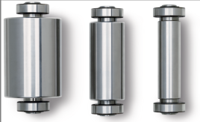
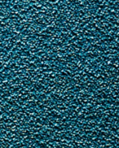
Grinding / Finishing accessories designed to work with GHB Grinding System
Material | Description of product
69903126000 | Grinding belt Cubitron II 50x1000mm grit 36 10 pack
69903127000 | Grinding belt Cubitron II 50x1000mm grit 60 10 pack
69903128000 | Grinding belt Cubitron II 50x1000mm grit 80 10 pack
69903157000 | Grinding belt Cubitron II 50x1150mm grit 36 10 pack
69903130000 | Grinding belt 50x1000mm 36 grit Z 10 pack
69903131000 | Grinding belt 50x1000mm 60 grit Z 10 pack
69903132000 | Grinding belt 50x1000mm 80 grit Z 10 pack
69903133000 | Grinding belt 50x1000mm 120 grit Z 10 pack
69903159000 | Grinding belt 50x1150mm 36 grit Z 10 pack
69903134000 | Grinding belt 50x1000mm 220 grit A 10 pack
69903135000 | Grinding belt 50x1000mm 320 grit A 10 pack
69903136000 | Grinding belt 50x1000mm 420 grit A 10 pack
69903137000 | Grinding belt 50x1000mm 36 grit R 10 pack
69903138000 | Grinding belt 50x1000mm 60 grit R 10 pack
69903139000 | Grinding belt 50x1000mm 80 grit R 10 pack
69903140000 | Grinding belt 50x1000mm 120 grit R 10 pack
69903158000 | Grinding belt 50x1150mm 36 grit R 10 pack
69903142000 | Fleece belts 50x1000mm coarse 3 pack
69903143000 | Fleece belts 50x1000mm medium 3 pack
69903144000 | Fleece belts 50x1000mm fine 3 pack
For more information, visit www.fein.com

